Slide 1

Joins II

Slide 2
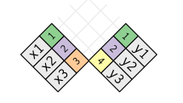
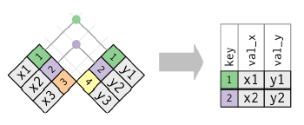
Graphical Depiction
Inner Join
Notes on Inner Join
Generally Inappropriate
Easy to Lose Observations

Slide 3
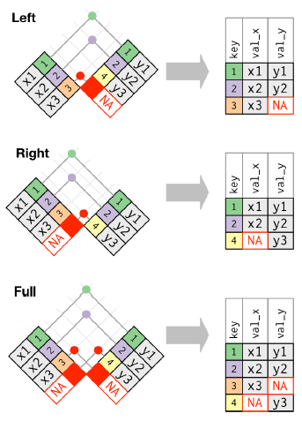
Graphical Depiction
Outer Join

Slide 4
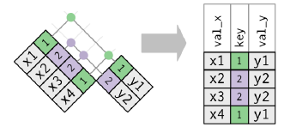
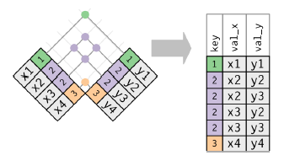
Graphical Depiction
Duplicate Keys
Using Left Join
One Table Has Duplicates
Both Tables Have Duplicates

Slide 5
Joins Assignment
Instructions
Download Analysis 2 File
Open Analysis 2 Rmd File
Knit to HTML
Read Introduction
Three Part Assignment
Part 1: Scrape Data
Part 2: Scrape Additional Data
Part 3: Merge Datasets
All Data in HTML Tables

Slide 6
Closing
Disperse and Make Reasonable Decisions

